Slide 1
Data Analytics: Module-3.2
Dr. Ramen Pal
Associate Professor
Department of CSE (AI & ML), UEMK
Contact: ramen.pal@uem.edu.in
WhatsApp: 7501038078

Slide 2
Course Details
Subject Name: Professional Elective - III : Data Analytics
Credit: 3
Subject Code: PECCSE602A
Lecture Hours: 36

Slide 3
Course Outcome
On completion of the course students will be able to:
  CO-1: Discuss with illustration the techniques and methods related to the area of data collection, pre-processing, and exploratory data analytics.
  CO-2: Discuss important terms and techniques on statistics to enable student to understand the background of different tools or methods used in data analytics.
  CO-3: Use at beginning level of proficiency on the tools of machine learning to ask questions of and explore patterns in data.
  CO-4: Demonstrate intermediate proficiency in the visualization of data to communicate information and patterns that exist in the data.

Slide 4
Syllabus: Module-3 (Foundation of Machine Learning)
Introduction, types of machine learning (supervised learning, unsupervised learning, and reinforcement learning) regression Regression (Linear, Logistic, Ridge, and Polynominal), Classification, Naïve bias classifier, KNN, Support Vector Machine, clustering, K-Means, ISODATA, Unconstrained optimization, Necessary and sufficiency conditions for optima, Optimization Models (Integer, Nonlinear, and Discrete), Gradient descent methods, Constrained optimization, KKT conditions, Introduction to nongradient techniques, Introduction to least squares optimization, Heuristic optimization, Meta-heuristic optimization. Introduction to ANN, Feed Forward Neural Network, Feedback Neural Network

Slide 5
Contents
Derivative-based Optimization
  Descent Methods
  The Method of Steepest Descent
  Classical Newton’s Method
  Step Size Determination
Derivative-free Optimization
  Genetic Algorithms
  Simulated Annealing
  Random Search
  Downhill Simplex Search

Slide 6
What is Optimization?
Choosing the best element from some set of available alternatives
Solving problems in which one seeks to minimize or maximize a real function

Slide 7
Notation of Optimization
Optimize
y=f(x₁,x₂….x_{n}) --------------------------------1
subject to
g_{j}(x₁,x₂…x_{n}) ≤ / ≥ /= b_{j} ----------------------2
where j=1,2,….n
Eqn:1 is objective function
Eqn:2 a set of constraints imposed on the solution.
x₁,x₂…x_{n} are the set of decision variables
Note:- The problem is either to maximize or minimize the value of objective function.

Slide 8
Complicating factors in optimization
Existence of multiple decision variables
Complex nature of the relationships between the decision variables and the associated income
Existence of one or more complex constraints on the decision variables

Slide 9
Types of optimization
Constraint:- Solution is arrived at by maximizing or minimizing the objective function
Unconstraint:- No constraints are imposed on the decision variables and differential calculus can be used to analyze them
Examples

Slide 10
System Identification
System Identification:- Determining a mathematical model for an unknown system by observing the input-output data pairs
System identification is required
  To predict a system behavior
  To explain the interactions and relationship between inputs and outputs
  To design a controller
System identification
  Structure identification
  Parameter identification

Slide 11
Structure identification
Apply a priori knowledge about the target system to determine a class of models within which the search for the most suitable model is conducted
y=f(u;θ)
y – model’s output
u – Input Vector
θ – parameter vector

Slide 12
Parameter Identification
Structure of the model is known and optimization techniques are applied to determine the parameter vector θ= θ

Slide 13
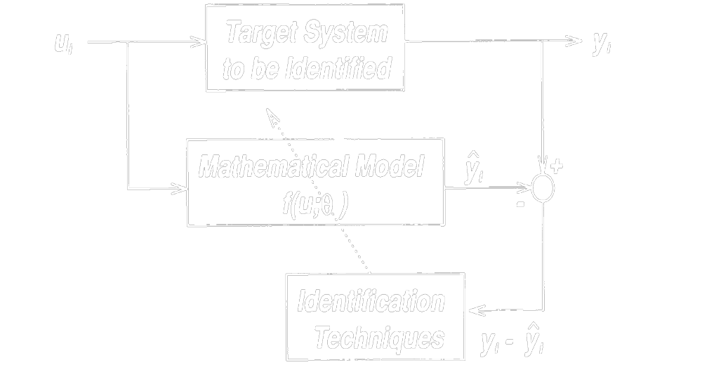
Block diagram of parameter identification

Slide 14
Parameter identification
An input ui is applied to both the system and the model
Difference between the target system’s output yi and model’s output yi is used to update a parameter vector θ to minimize the difference
System identification is not a one-pass process; it needs to do both structure and parameter identification repeatedly

Slide 15
Classification of Optimization algorithms
Derivative-based algorithms:-
Derivative-free algorithms

Slide 16
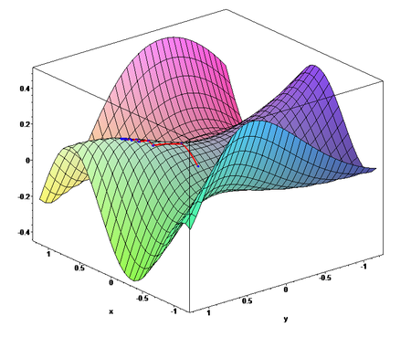
Gradient Descent Method is a first-order optimization algorithm. To find a local minimum of a function, one takes a step proportional to the negative of the gradient of the function at the current point.
This demo illustrates the Gradient Descent Method.

Slide 17
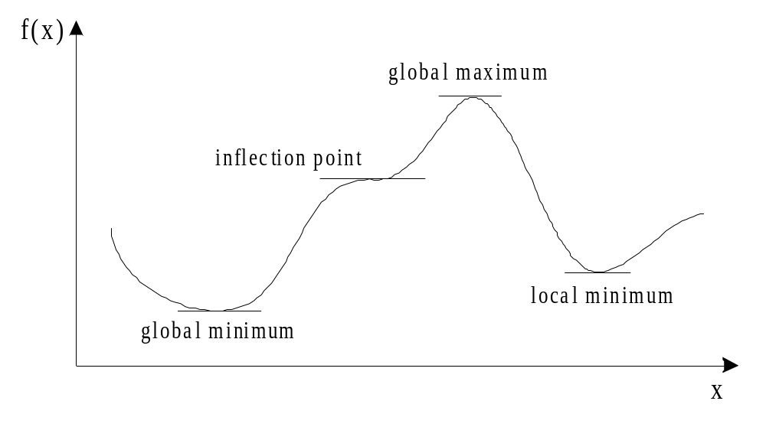
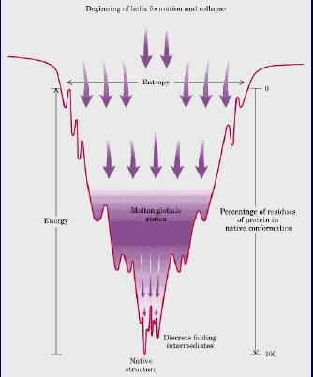
Gradient Descent Method
Gradient is the slope of a function.
Optimization is finding the “best” value of a function which is the minimum value of the function.
The number of “turning points” of a function depend on the order of the function.
Not all turning points are minima.
The least of all the minimum points is called the “global” minimum.
Every minimum is a “local” minimum.

Slide 18
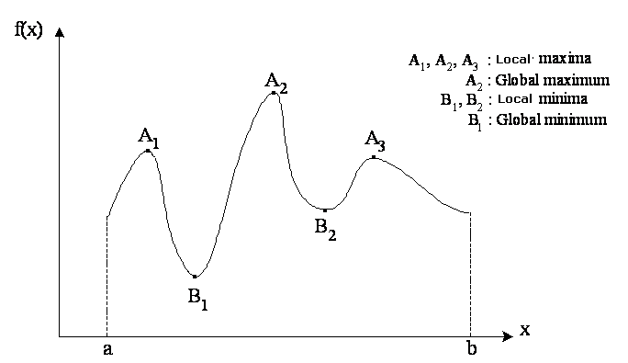
Function:

Slide 19
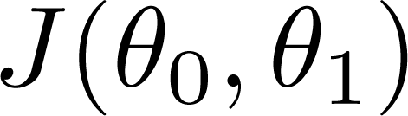
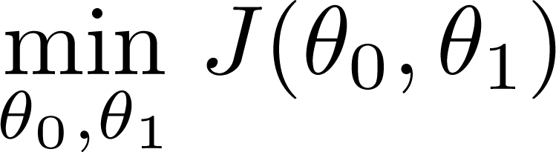
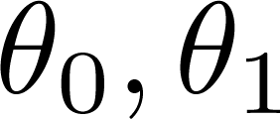
Have some function
Want
Gradient descent algorithm outline:
  Start with some
  Keep changing to reduce until we hopefully end up at a minimum

Slide 20
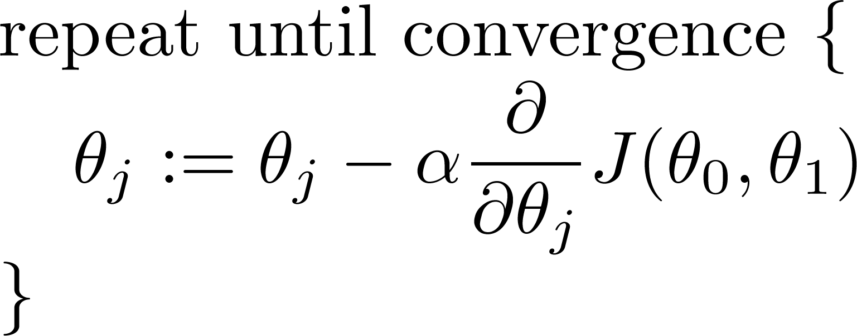
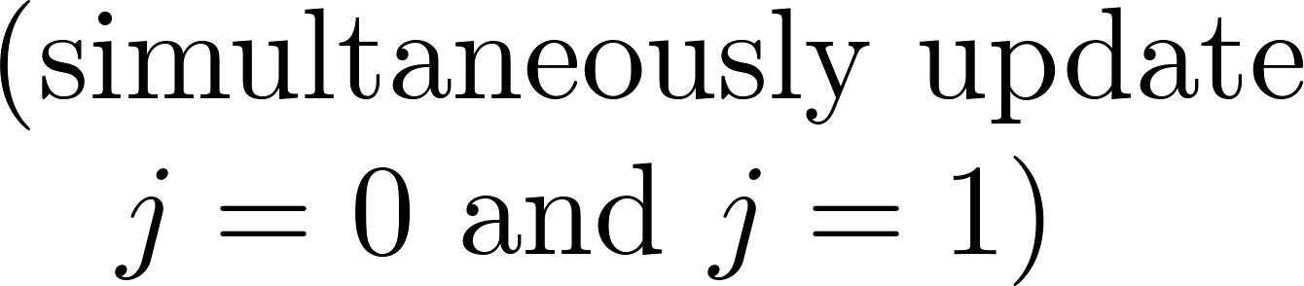
Have some function
Want
Gradient descent algorithm

Slide 21
Have some function
Want
Gradient descent algorithm
learning rate

Slide 22
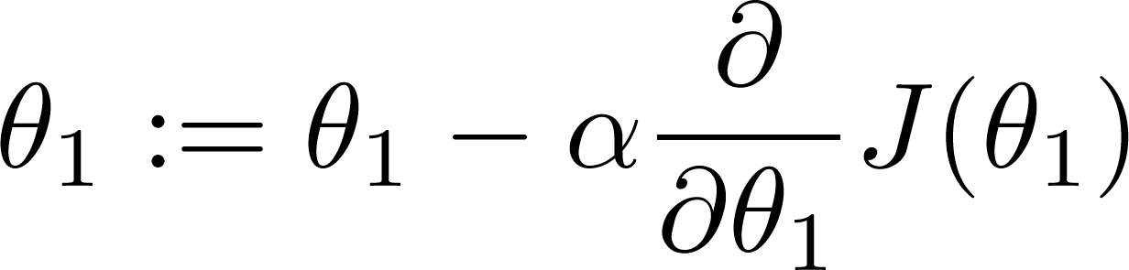

If α is too small, gradient descent can be slow.
If α is too large, gradient descent can overshoot the minimum. It may fail to converge, or even diverge.

Slide 23

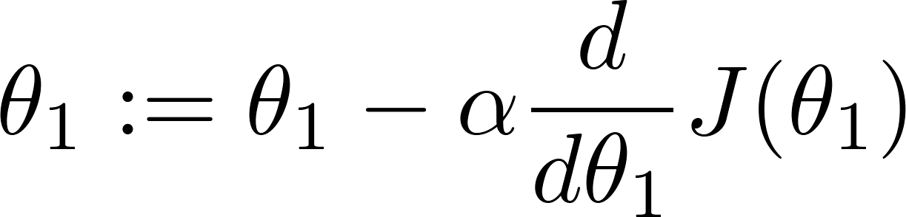
at local minimum
Current value of

Slide 24
Gradient descent can converge to a local minimum, even with the learning rate α fixed.

Slide 25
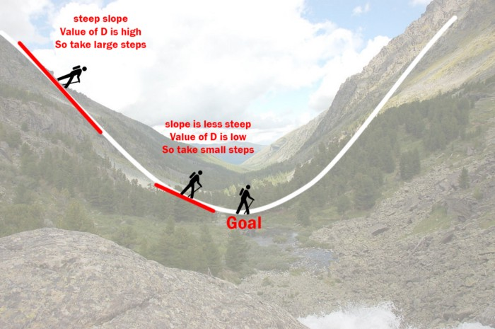
Recap: What We’ve Learned

Slide 26
Recap: What We’ve Learned
Gradient descent algorithm
Parameter:

Slide 27
Recap: What We’ve Learned
Gradient descent algorithm
Parameter: Loss Function

Slide 28
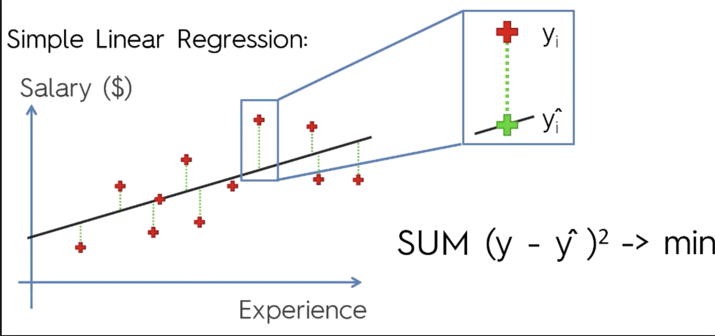
Recap: What We’ve Learned
Loss Function
Error Functions

Slide 29
Recap: What We’ve Learned
Loss Function
Mean Squared Error
Error Functions

Slide 30


Recap: What We’ve Learned
Loss Function
Error Functions
  Mean Squared Error (MSE):
  Sum of Squared Error (SSE):
  Etc.

Slide 31
Recap: What We’ve Learned
Loss Function

Slide 32
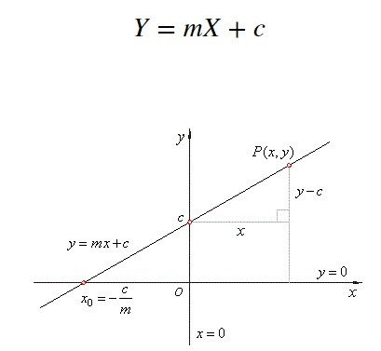
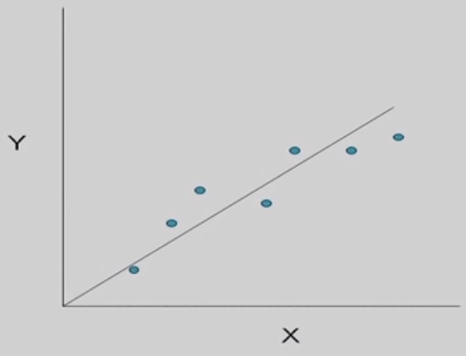
Linear Regression

Slide 33
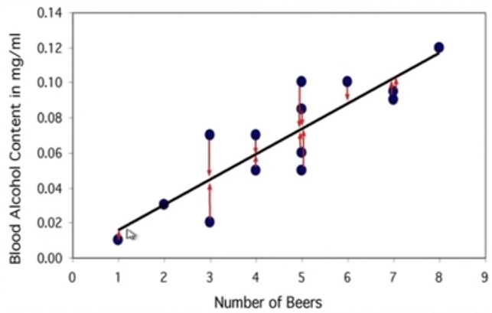
Linear Regression

Slide 34
Linear Regression

Slide 35
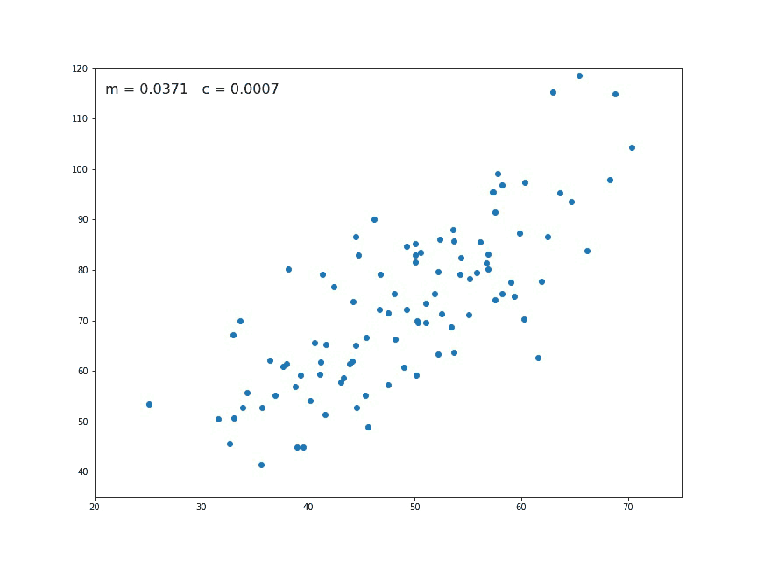
Linear Regression with Gradient Descent

Slide 36
Linear Regression with Gradient Descent
Loss Function

Slide 37

Linear Regression with Gradient Descent
Loss Function

Slide 38
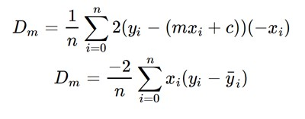
Linear Regression with Gradient Descent
Loss Function

Slide 39

Linear Regression with Gradient Descent
Loss Function

Slide 40
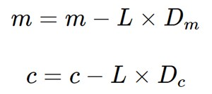
Linear Regression with Gradient Descent
Loss Function

Slide 41



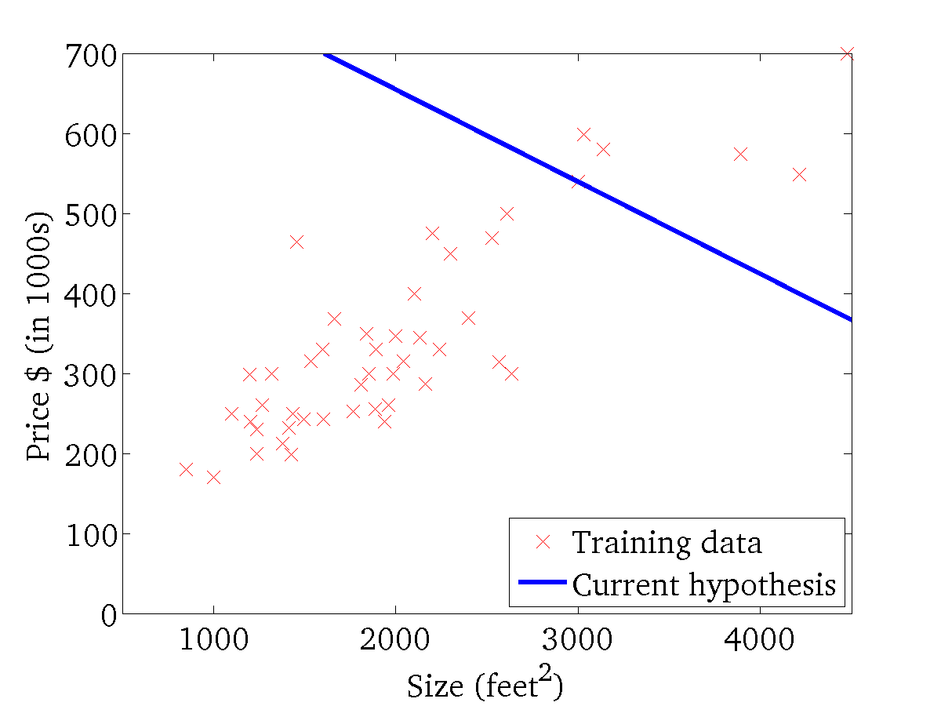
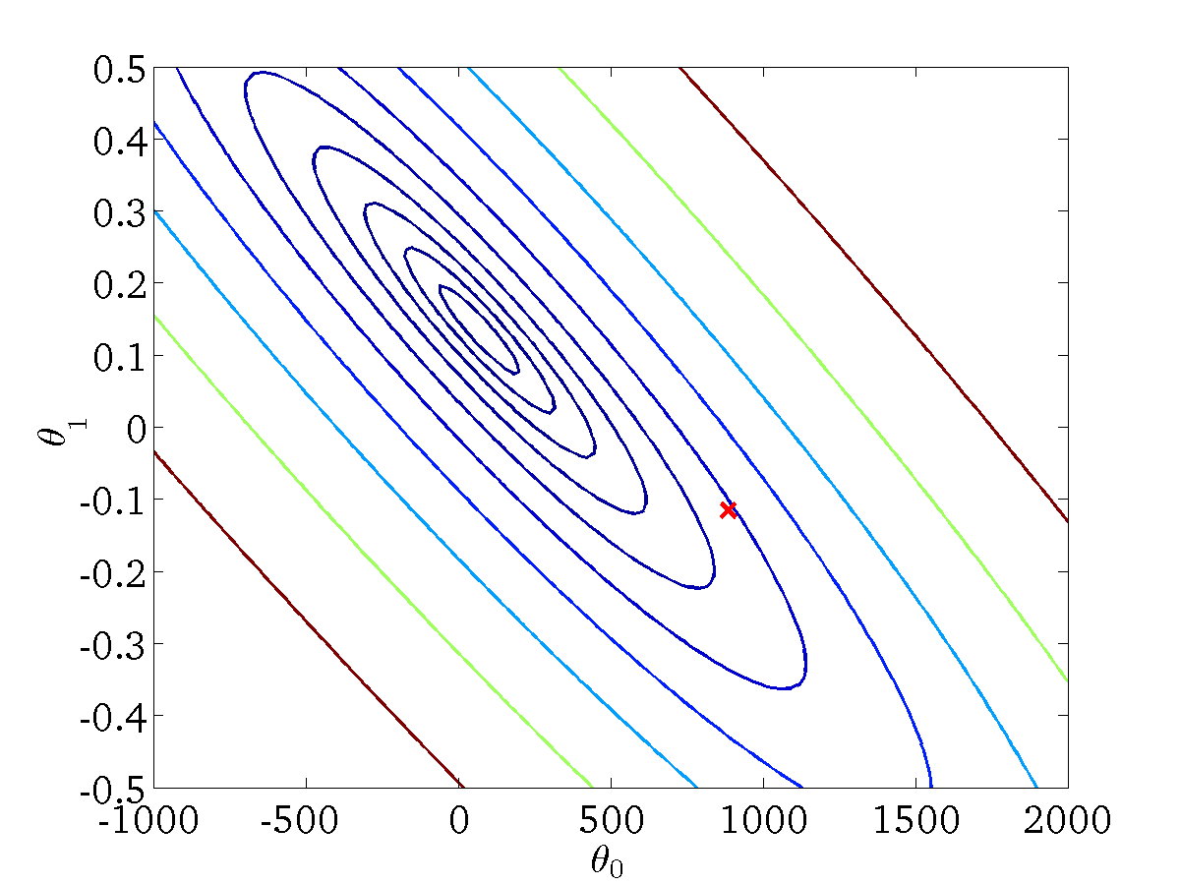
(for fixed , this is a function of x)
(function of the parameters )

Slide 42
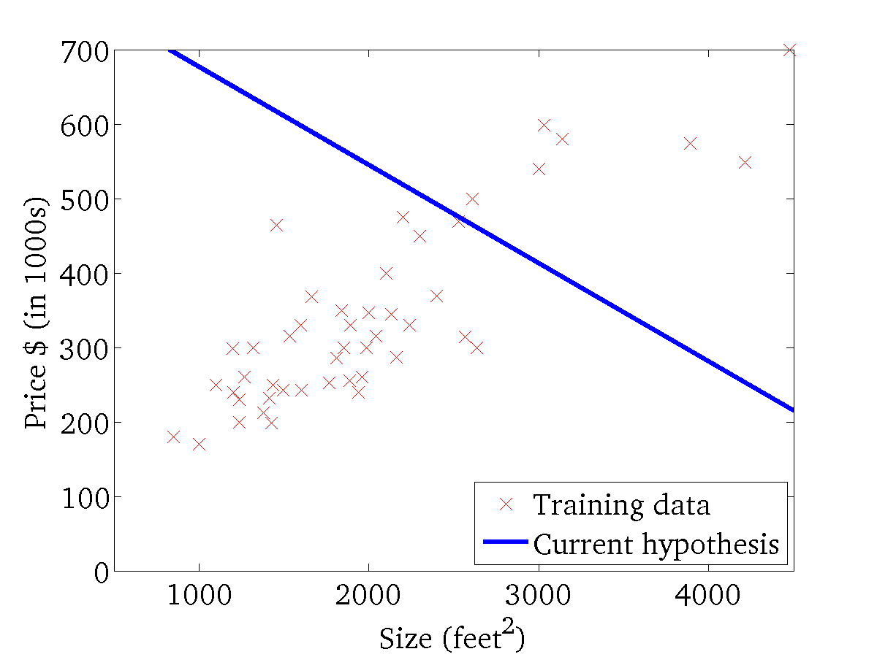

(for fixed , this is a function of x)
(function of the parameters )

Slide 43
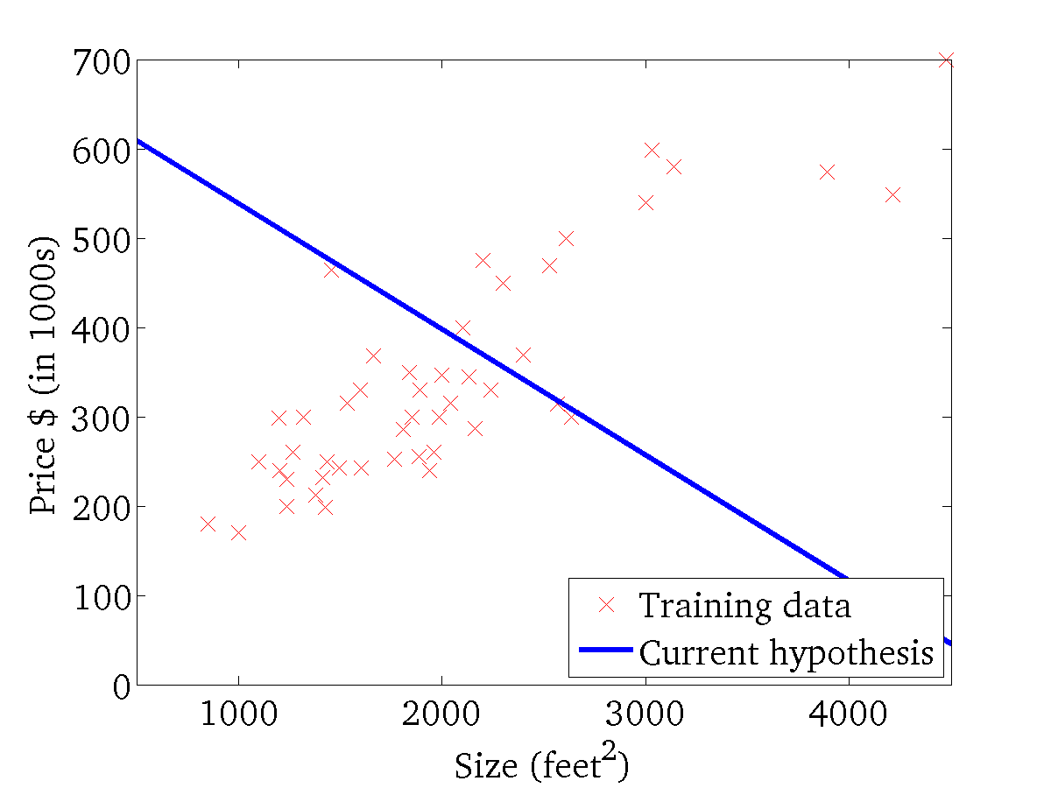
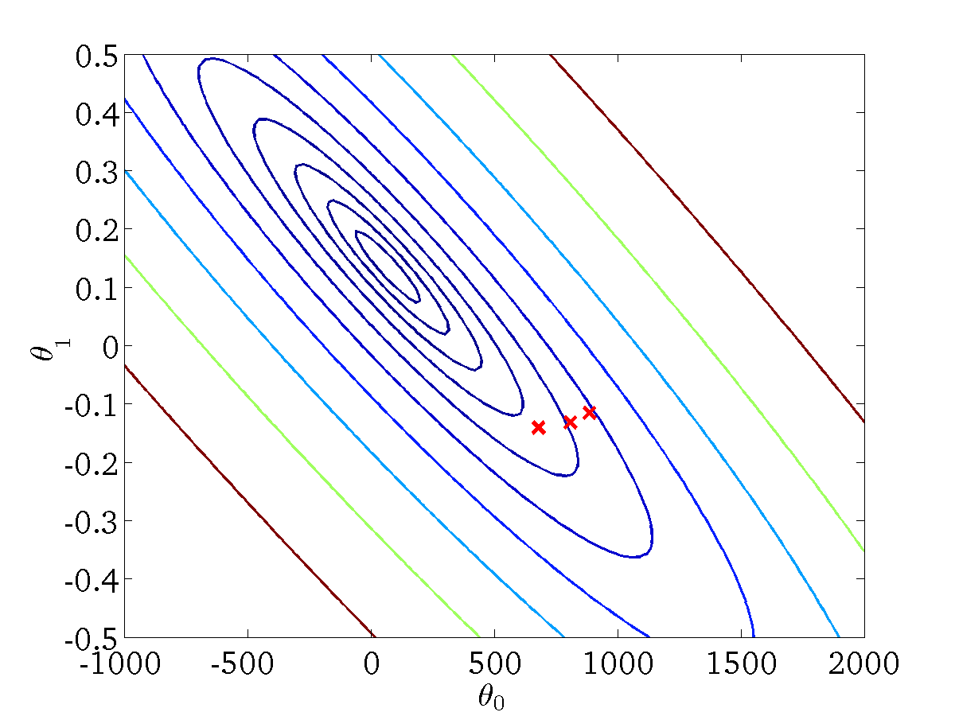
(for fixed , this is a function of x)
(function of the parameters )

Slide 44
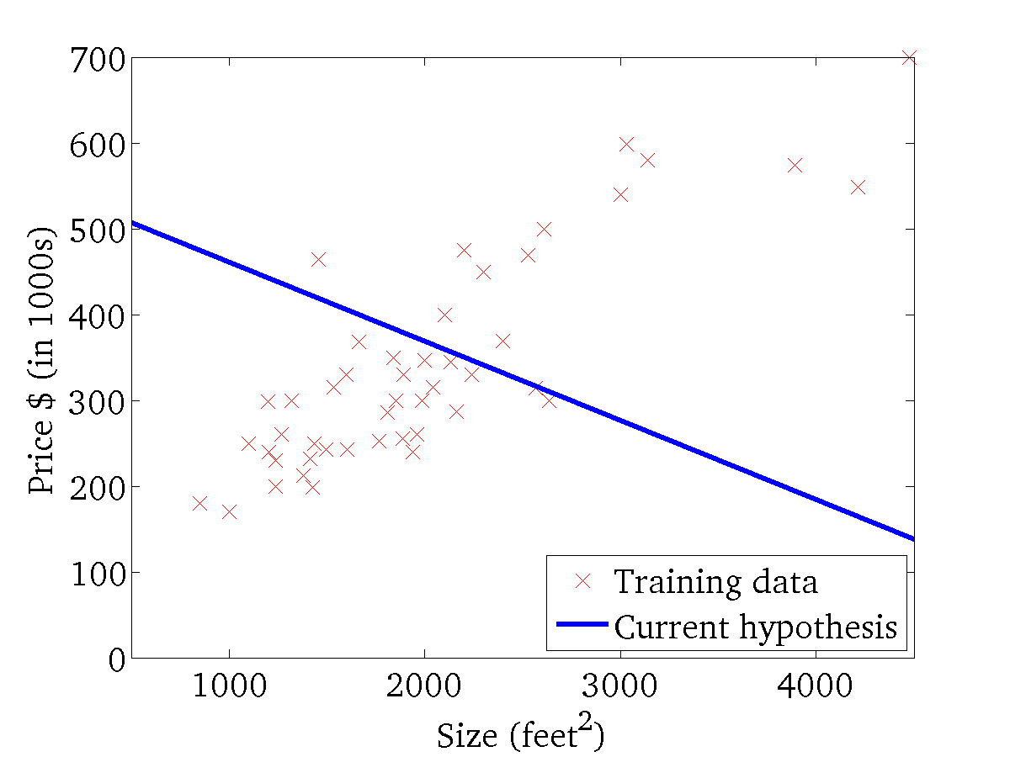

(for fixed , this is a function of x)
(function of the parameters )

Slide 45
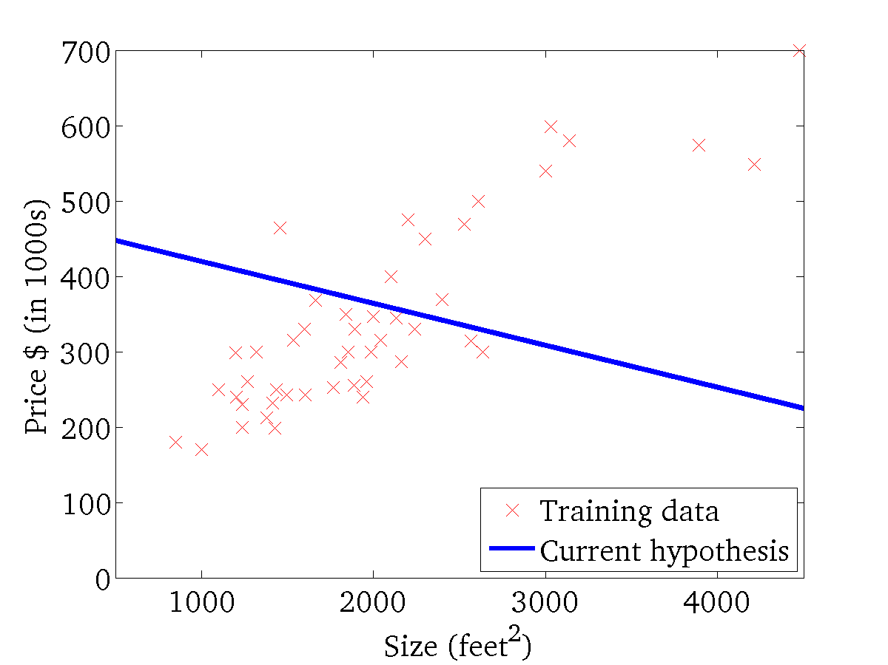
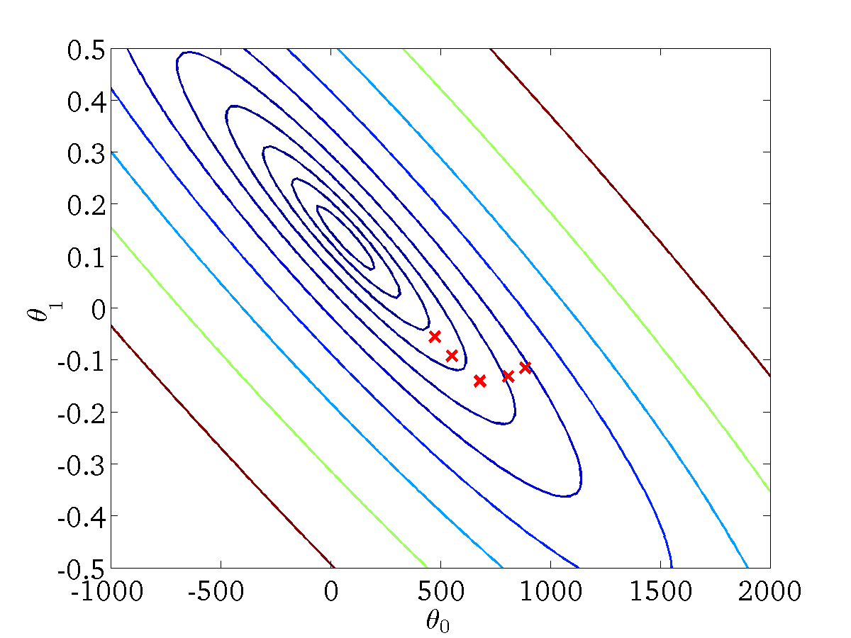
(for fixed , this is a function of x)
(function of the parameters )

Slide 46
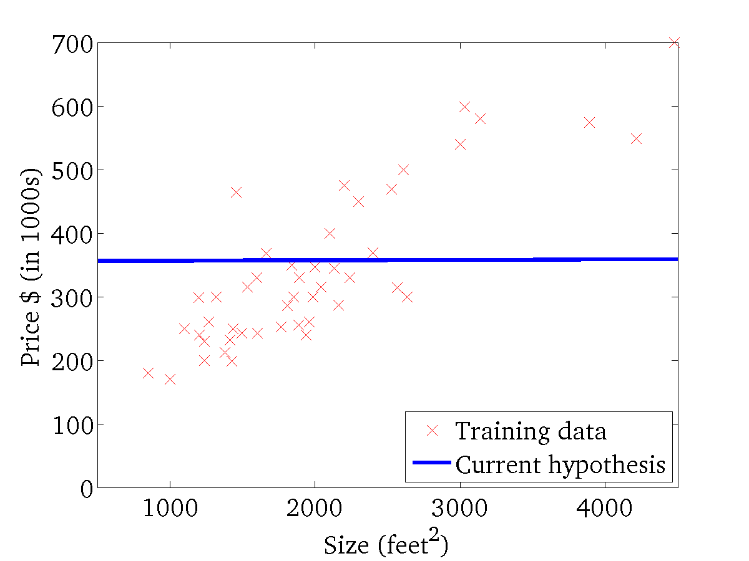

(for fixed , this is a function of x)
(function of the parameters )

Slide 47
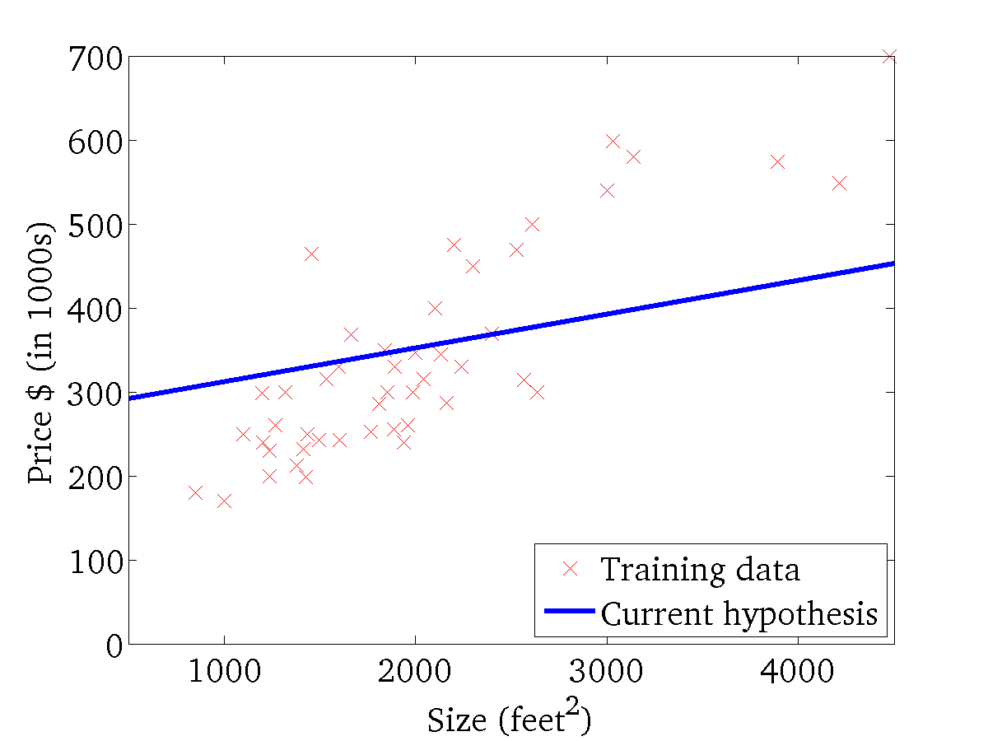

(for fixed , this is a function of x)
(function of the parameters )

Slide 48
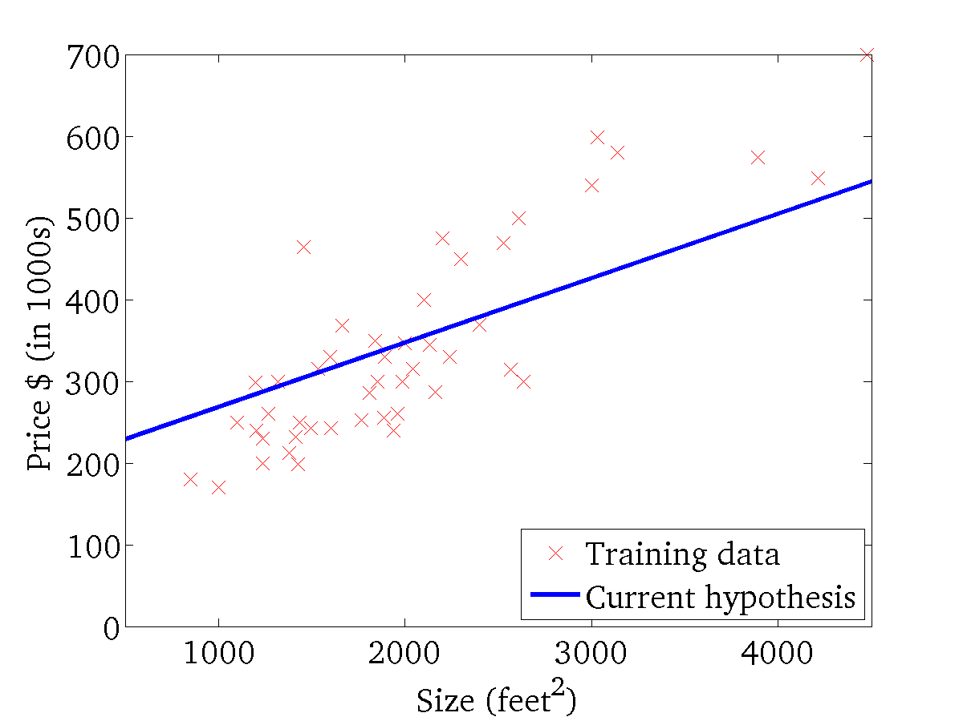
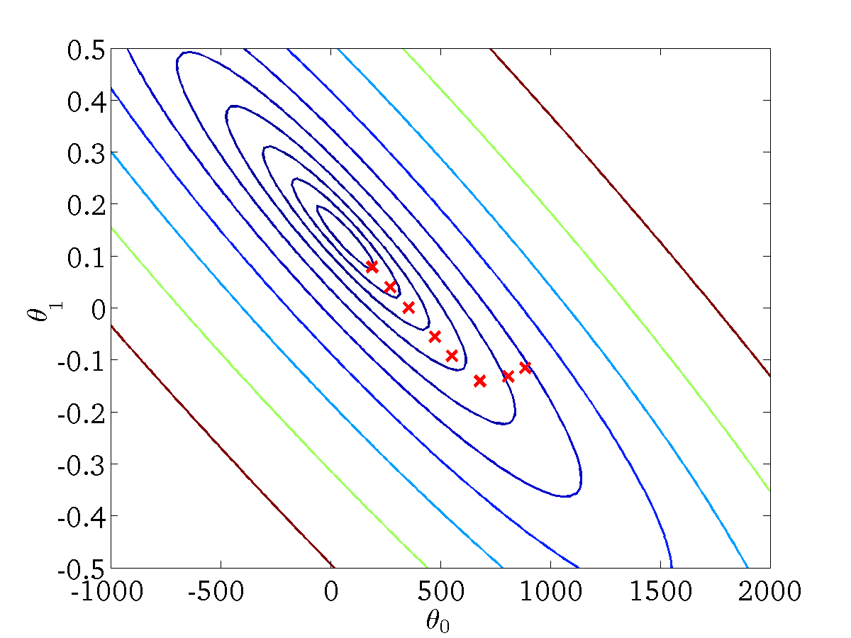
(for fixed , this is a function of x)
(function of the parameters )

Slide 49
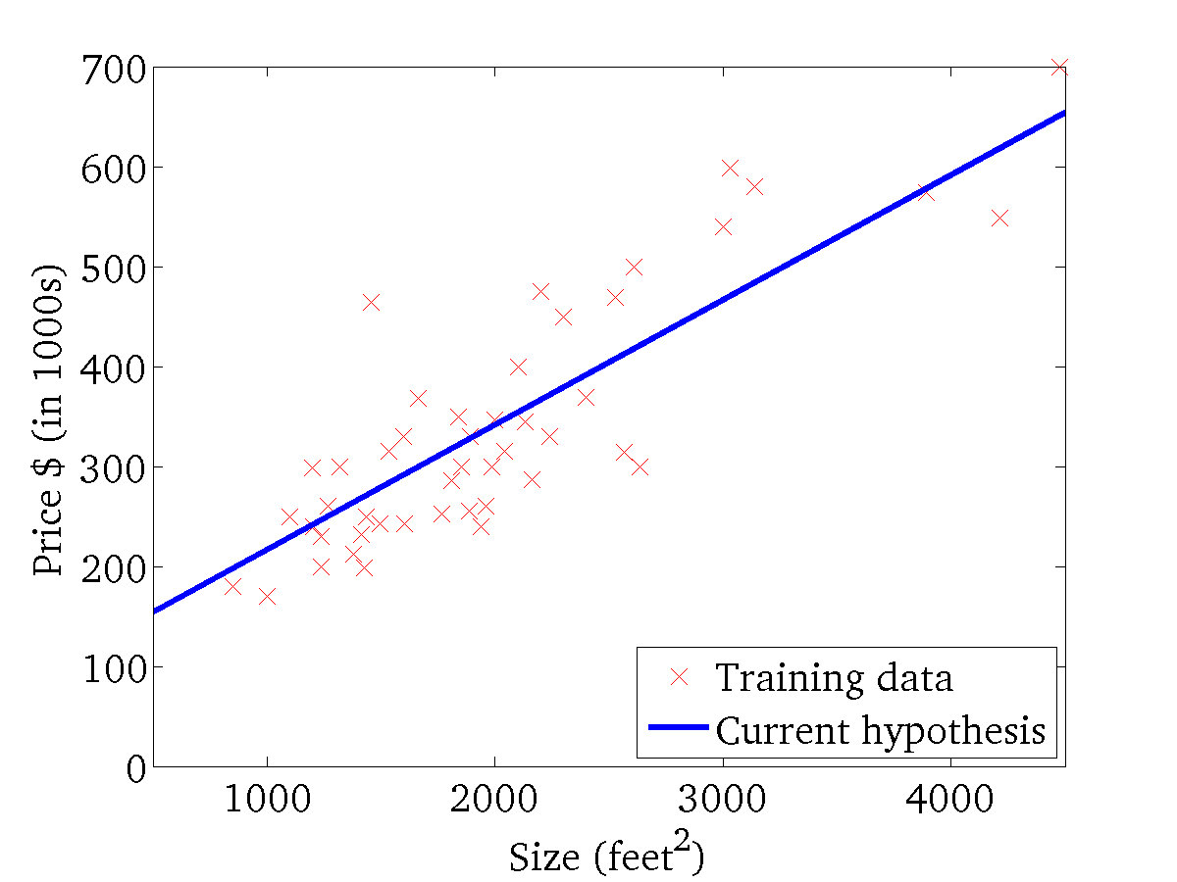

(for fixed , this is a function of x)
(function of the parameters )

Slide 50
“Batch” Gradient Descent
“Batch”: Each step of gradient descent uses all the training examples.
Alternative: process part of the dataset for each step of the algorithm.

Slide 51
Stochastic Gradient Descent
Mini Batch Gradient Descent

Slide 52
Characteristics of derivative free algorithm
Derivative freeness:- repeated evaluation of objective function
Intuitive guidelines:- concepts are based on nature’s wisdom, such as evolution and thermodynamics
Slower
Flexibility
Randomness:- global optimizers
Analytic Opacity:-knowledge about them are based on empirical studies
Iterative nature:-

Slide 53
Characteristics of derivative free algorithm
Stopping condition of iteration:- let k denote an iteration count and fk denote the best objective function obtained at count k. stopping condition depends on
  Computation time
  Optimization goal;
  Minimal Improvement
  Minimal relative improvement

